Slide 1
Weekly Presentation
Jiayu Chen
2023.8.21
Notes:
Ok, I will begin my weekly Presentation

Slide 2
Work Description
Work_1: Tutorial Writing
Work_2: Using the SSA + Template method, for SCG signals with no RR and a 0.8 noise level, S decreases from last week's 3.9 to 1.64, while D increases from 5.8 to 6.2.
Work_3: Using the SSA method from last week for SCG signals with RR and a 0.8 noise level, S remains almost unchanged, staying at around 3.9, while D increases from 5.8 to 7.1.
Work_4: Theoretical knowledge Learning

Slide 3
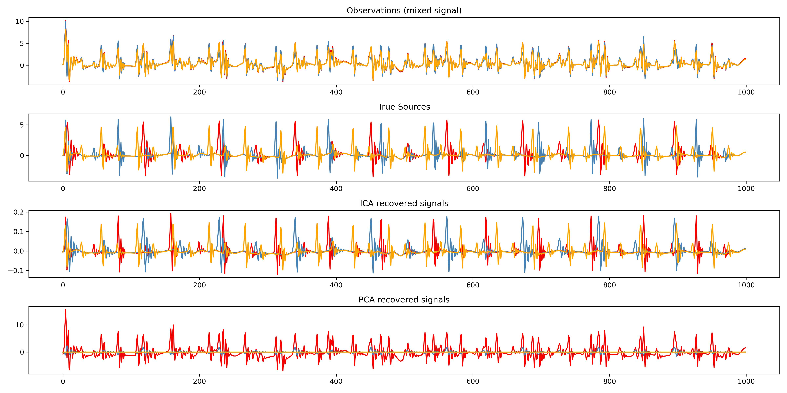
Work_1: Tutorial
Blind Source Separation
Simulating 3 persons in bed with 3 sensors for monitoring
Limitation:
The number of observed persons is equal to the number of monitoring sensors.
Current simulated SCG dataset cannot be used with this method.
Notes:
Blind Source Separation
I Simulate 3 persons in bed with 3 sensors for monitoring
The SCG signals of the 3 persons will interact with each other, so each sensor will actually receive signals from all 3 persons.
Limitation:
The number of observed persons is equal to the number of monitoring sensors.
So，Current simulated SCG dataset cannot be used with this method.

Slide 4
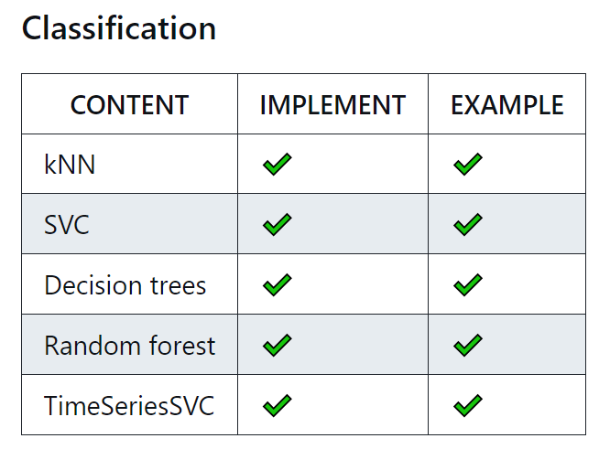
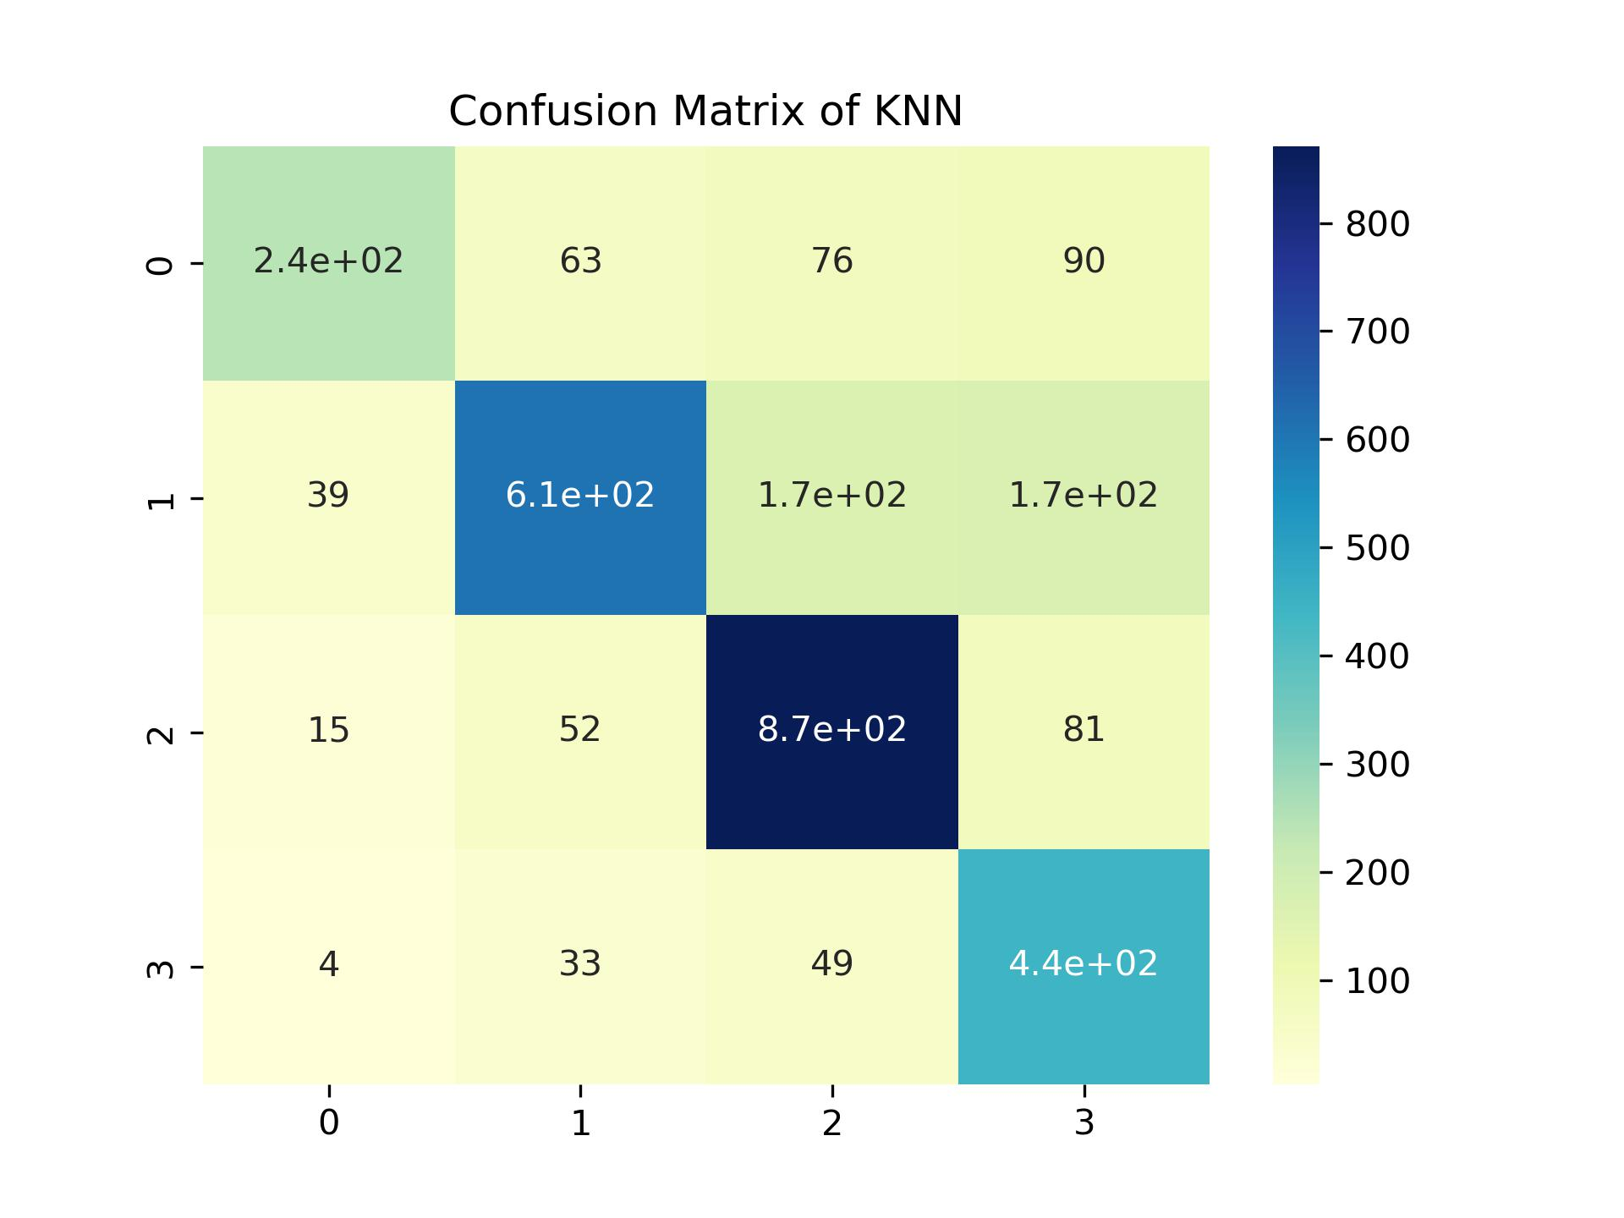
Work_1: Tutorial
1. Modified the SCG simulator to directly generate templates.
2. Divided S values ranging from 90 to 180 into four categories.
3. Then input these templates into these five classifiers.
4. Used Accuracy and Confusion Matrix to evaluate the performance.
Because the input is a time series, the performance is not good overall.
KNN performs the best with an accuracy of over 0.75, while the SVC, DT, and RF have poor performances.
TimeSeriesSVC ran for two hours without producing results.
Notes:
Left hand picture is the confusion matrix of KNN, the result is just so so.

Slide 5
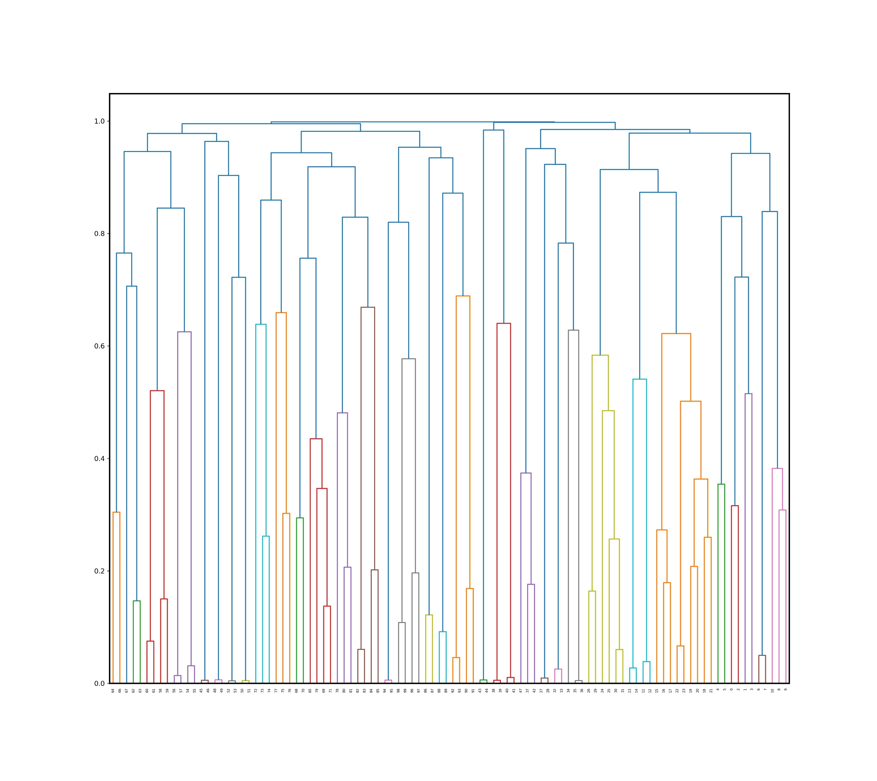
Work_2: S & D prediction in the noise level of 0.8
It seems that two Automatic SSA methods used in paper don’t work.
The descriptions provided in Automatic Singular Spectrum Analysis and Forecasting are overly inadequate. And the approach is unworkable.
The clustering-based method mentioned in Automatic Grouping in Singular Spectrum Analysis also has problems.
The Trend we need.
We can hardly precisely pick it out from so many branches.
Notes:
We can see in the below figure, it the result of h clustering. The components in the red box is the Trend we need.
Since diff signal has diff hi tree. We can hardly precisely pick it out from so many branches.

Slide 6
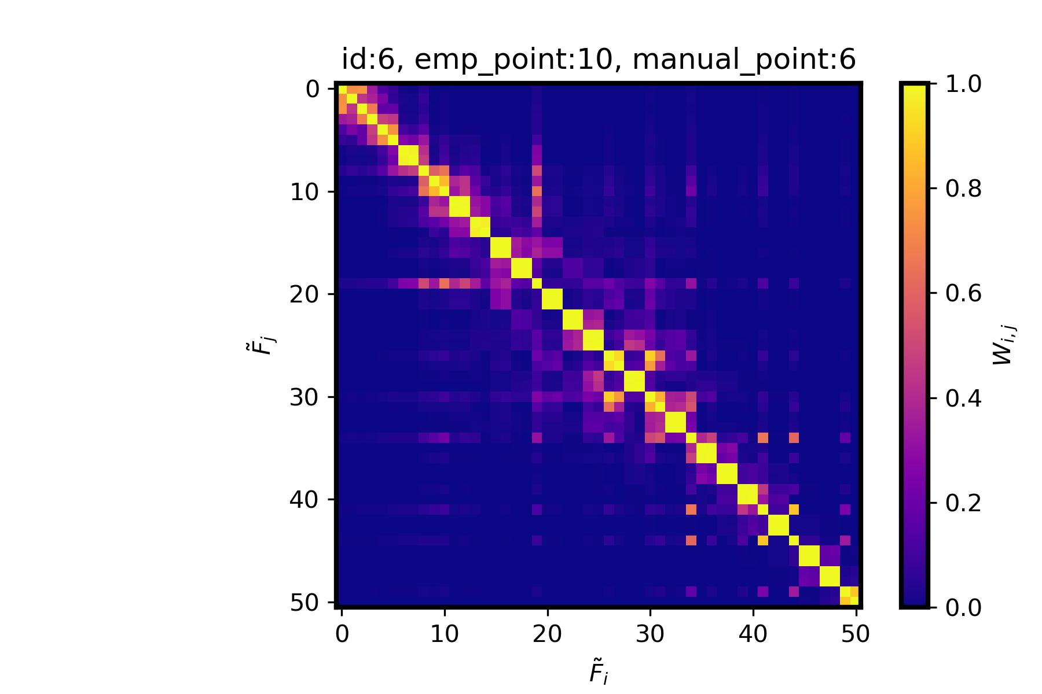
Work_2: S & D prediction in the noise level of 0.8
Propose a search-based automated grouping algorithm
-- simulate how people group SSA manually
N Components
For Trend
Diagonal of the W matrix
Effective matric:
the fill rate within the hexagon
Square X (a complete failure)
Averages X (a complete failure)
Notes:
SO, I attempt to propose a search-based automated grouping algorithm.
The yellow line on the left represents the diagonal of the W matrix.
I try to simulate how people group them manually.
After many attempts, I find that using the fill rate within the hexagon is a highly effective metric.
Using squares or averages, for example, would result in a complete failure of the search.
The fill rate within the shaded area of the hexagon shows promising potential for success.

Slide 7
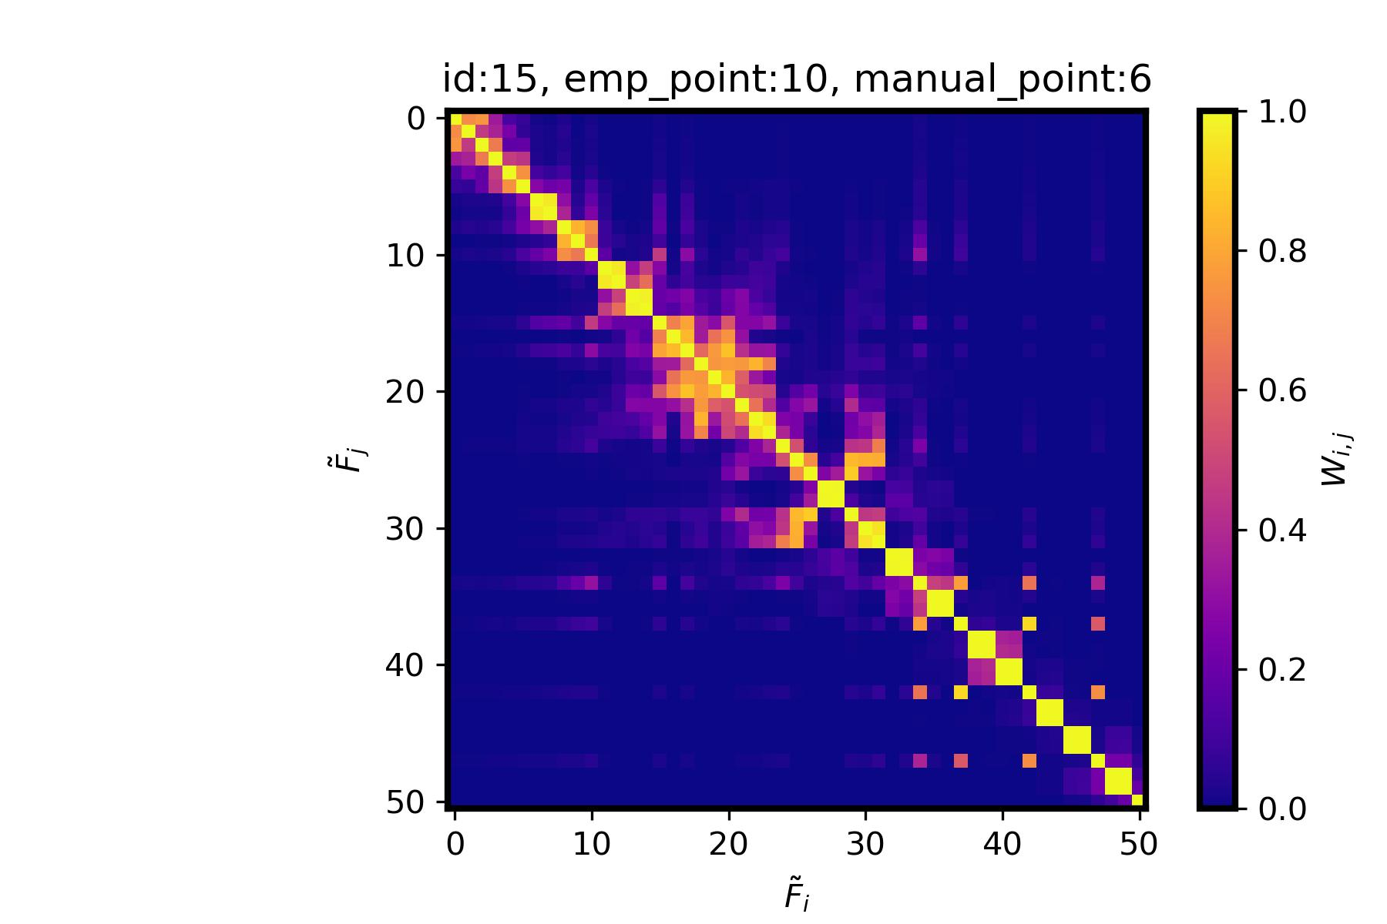
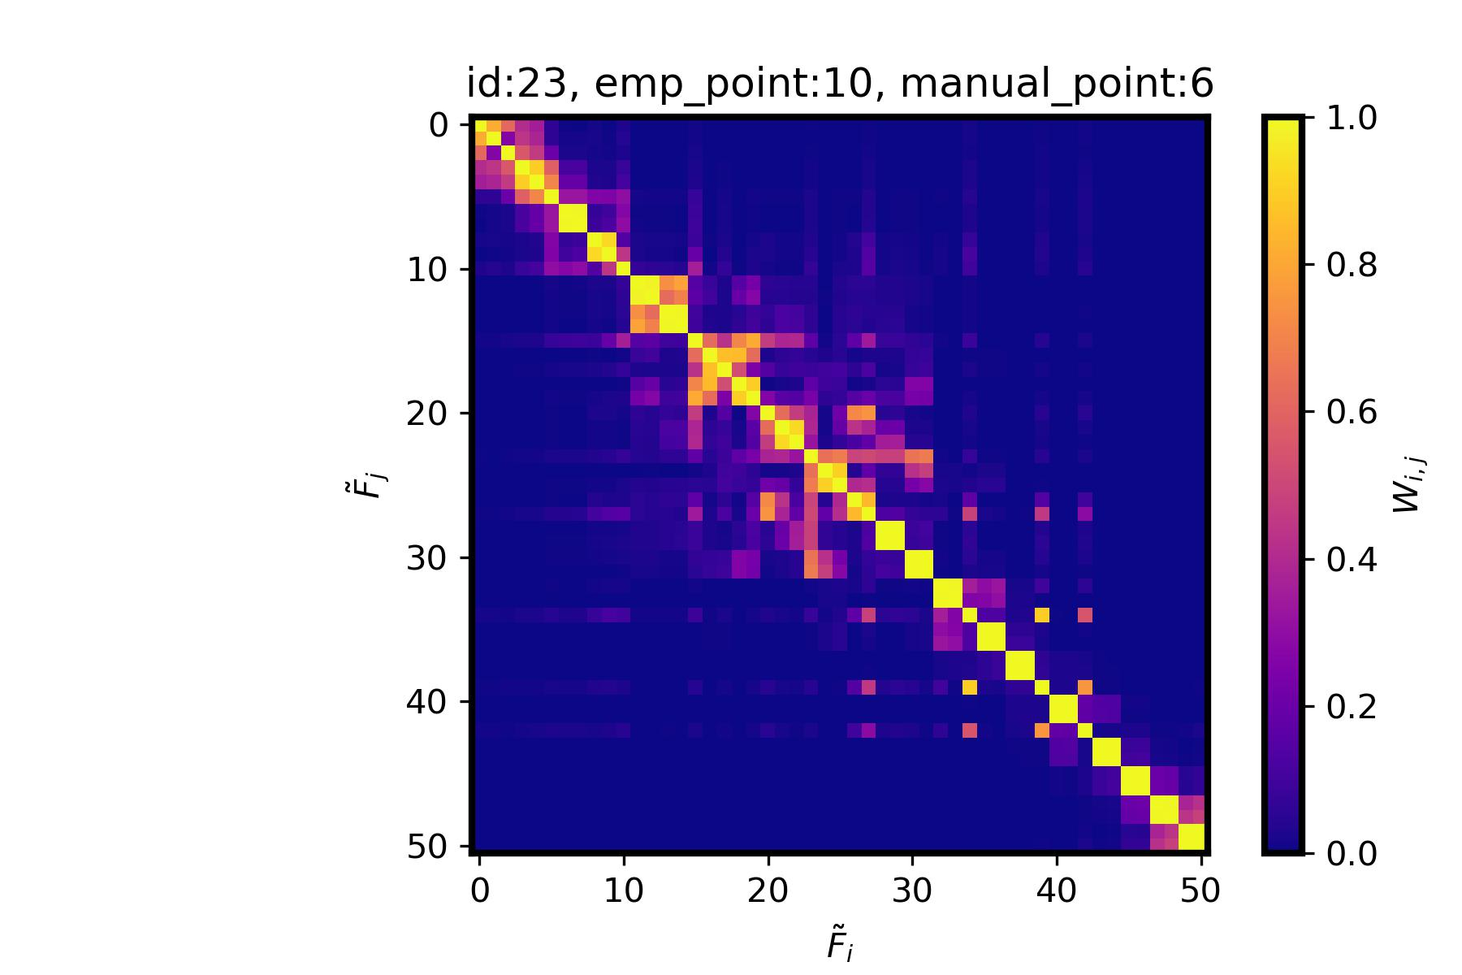
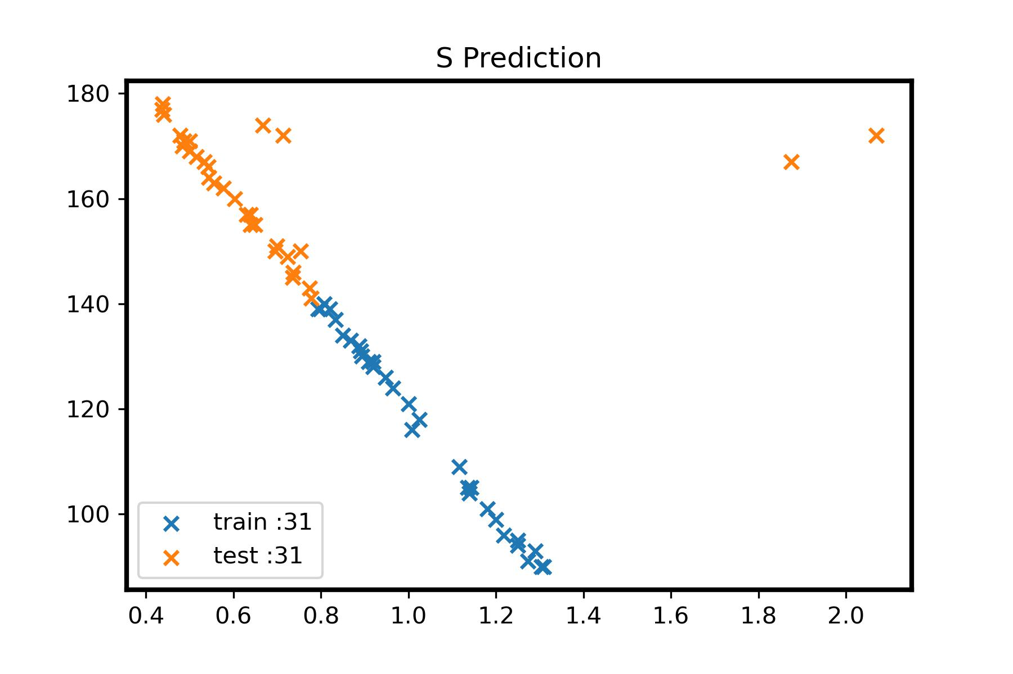
Work_2: S & D prediction in the noise level of 0.8
whether you choose 6 or 10 components, it has no impact.
choose 10 components
choose 10 components
We even can’t determine how to group them manually.
So it's challenging to provide an accurate stopping condition for the search.
Notes:
The reason I mentioned that this method has potential rather than being already successful is because it still has an issue that needs to be resolved.
Let's consider three sets of examples:
In the first figure on the left, regardless of whether you choose 6 or 10 components, it has no impact.
However, in the two figures on the right, if you choose 10 components, they will become outlier. On the other hand, choosing 6 components allows for normal feature extraction.
In the last two figures, it's difficult for us to judge by eyes whether it should be 6 or 10 components.
We even can’t determine how to group them manually.
So it's challenging to provide an accurate stopping condition for the search.

Slide 8
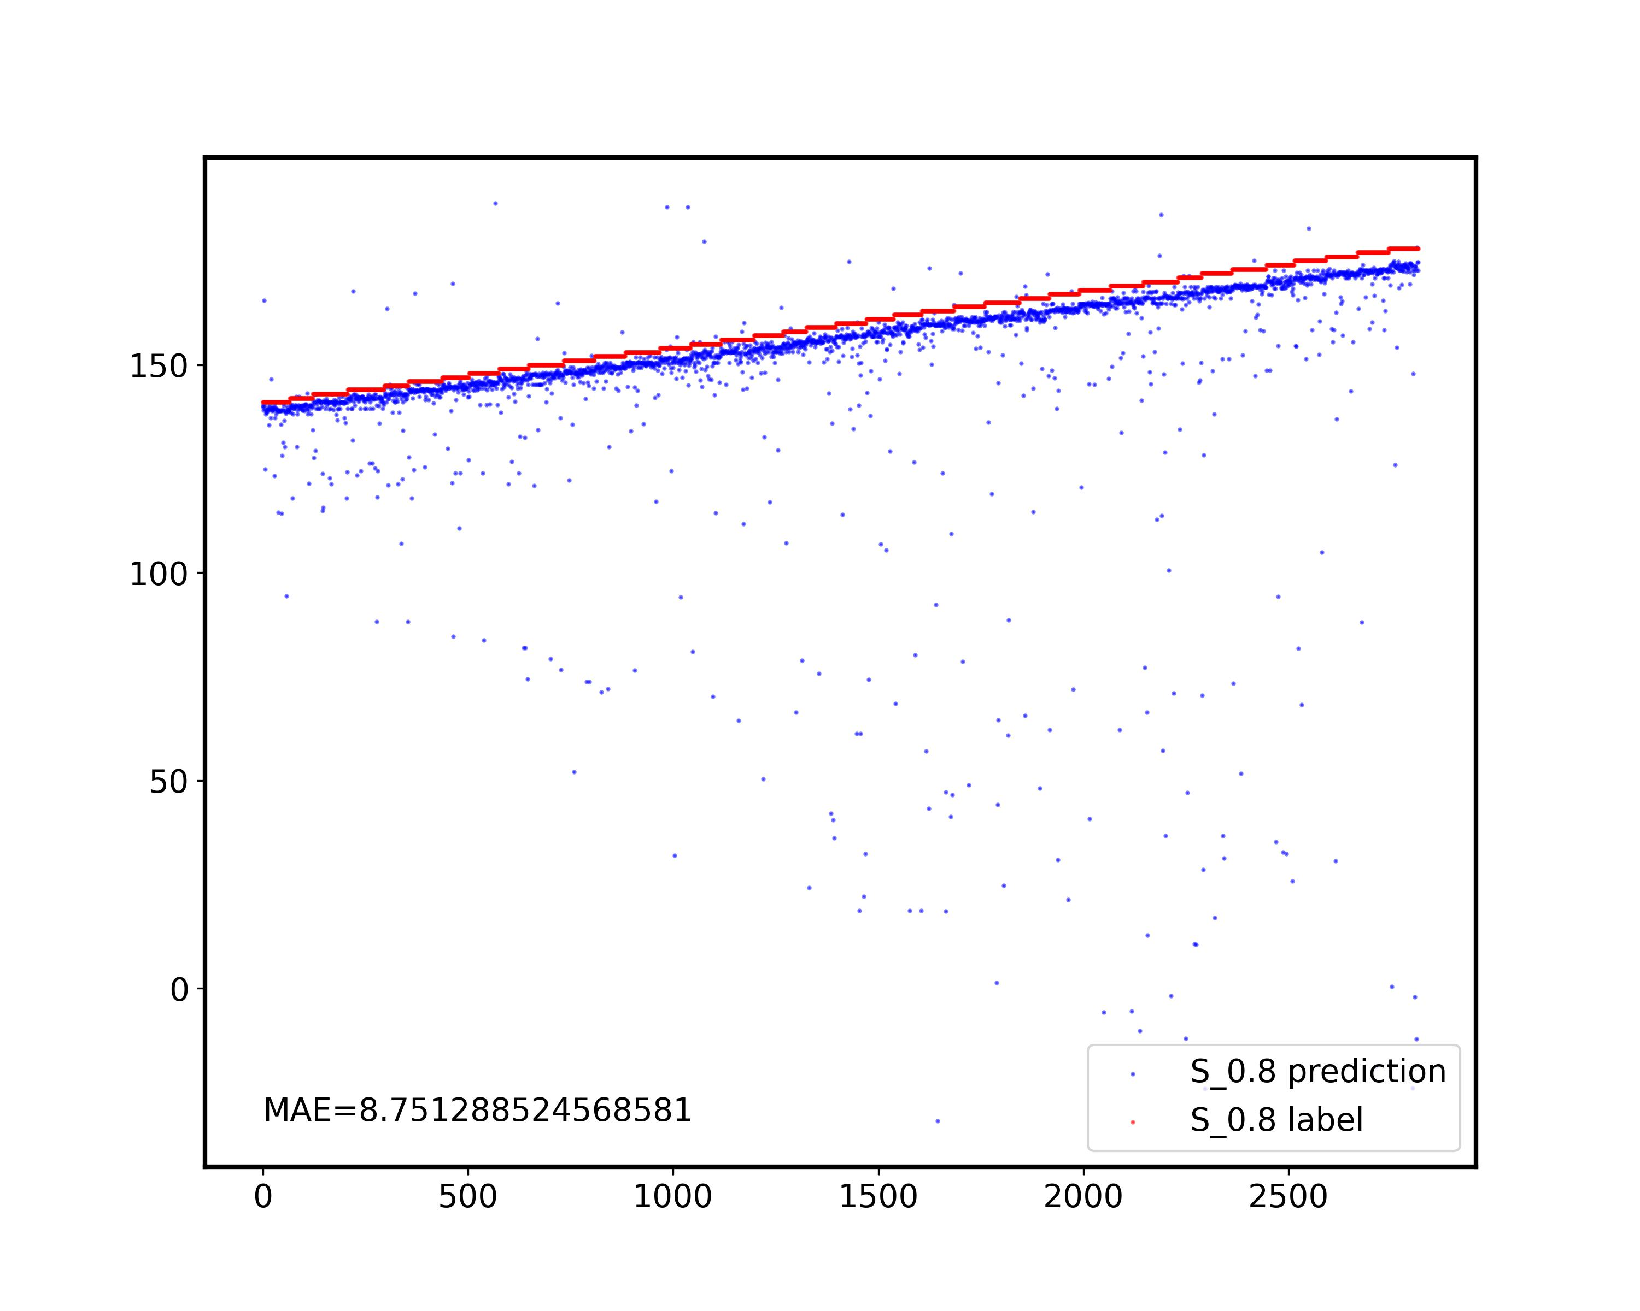
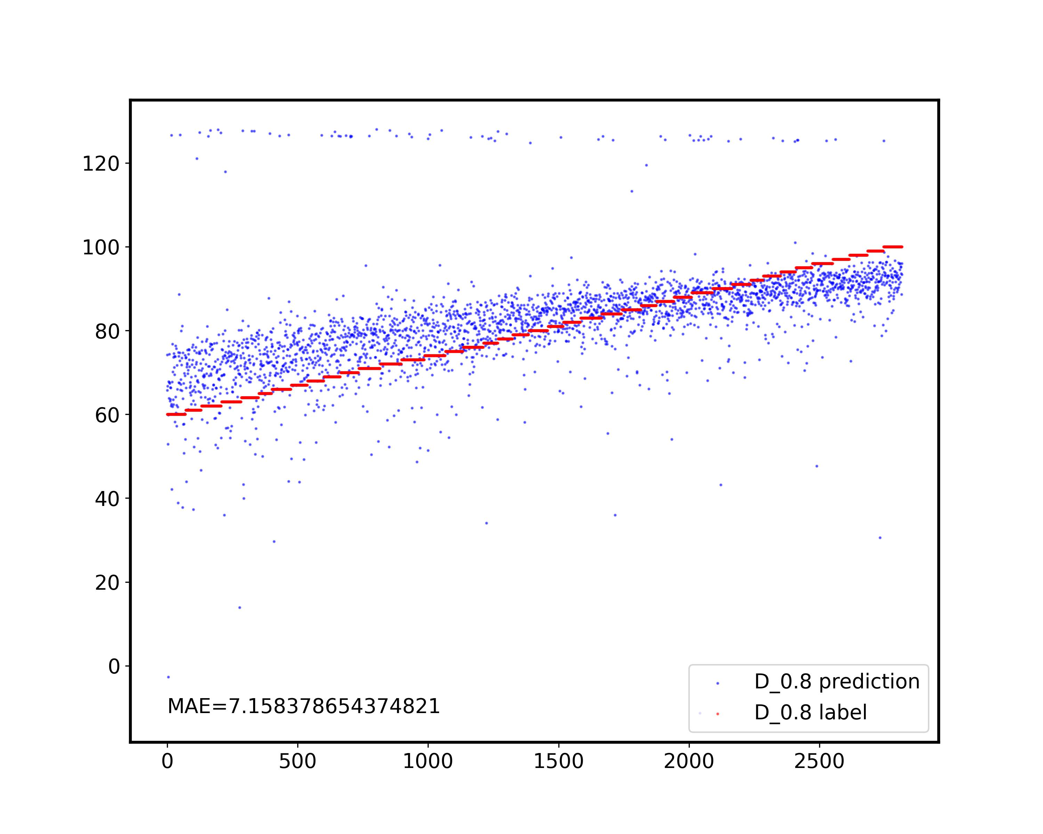
Work_2: S & D prediction in the noise level of 0.8
S
D
There is still a significant gap between the empirical SSA grouping and this search-based SSA automatic grouping method.
However, this doesn't mean that the method is unworkable.
Notes:
there is a significant gap between the empirical SSA grouping and this search-based SSA automatic grouping method.
However, this doesn't mean that the method is unworkable.
On the contrary, compared to the previous SSA methods that are completely unworkable, I believe this method has the potential for further exploration and improvement. If we can determine how to group them manually, this method will work effectively.

Slide 9
The goal is to get key features. Achieving better automatic SSA grouping is just one of means, rather than goal.
However, the difference between fine and coarse grouping doesn't result in significant errors.
The majority of errors occur at this step.
Work_2: S & D prediction in the noise level of 0.8
Last week
This week
Noisy Signals
(Noise: 0.8, No RR)
Noisy Signals
(Noise: 0.8, No RR)
SSA
SSA
Challenging
Split the signal to obtain template
Extract features on 10-second SCG signal
Extract features on template
Easy!
After using SSA, We can perfectly identify all large peaks.
Obtain key features
Obtain key features
S, D Prediction
S, D Prediction

Slide 10
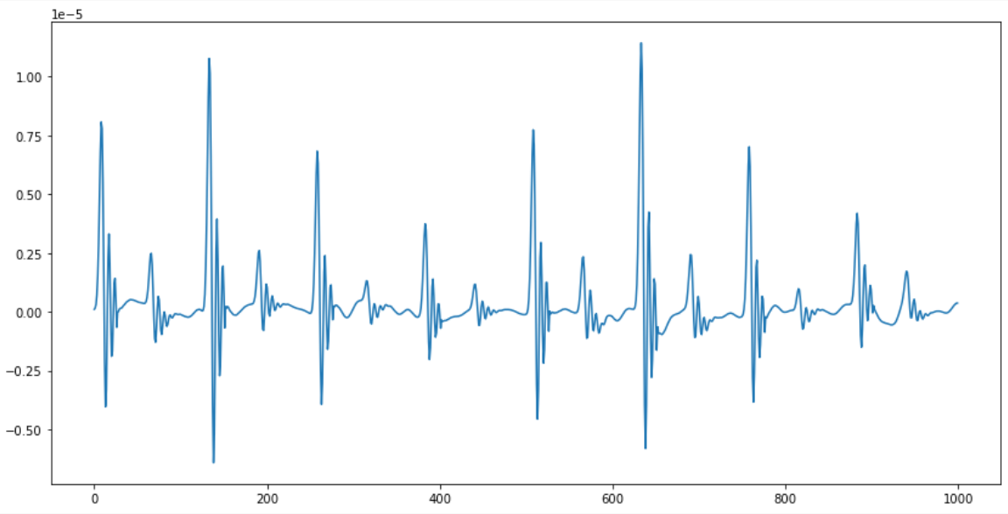
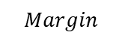
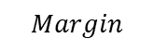
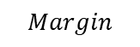
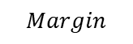
Work_2: S & D prediction in the noise level of 0.8
Segmentation based on large peaks and margins
Get Averages
Obtain Templates
$$Margin$$
$$Margin$$
$$Margin$$
$$Margin$$
$$Margin$$
One piece of sliced signal
Notes:
I did not use the combination of cycles and clustering to obtain the template this time.
Instead, I use the method based on large peaks and margins I proposed during the first presentation.
It is easy but it works.

Slide 11
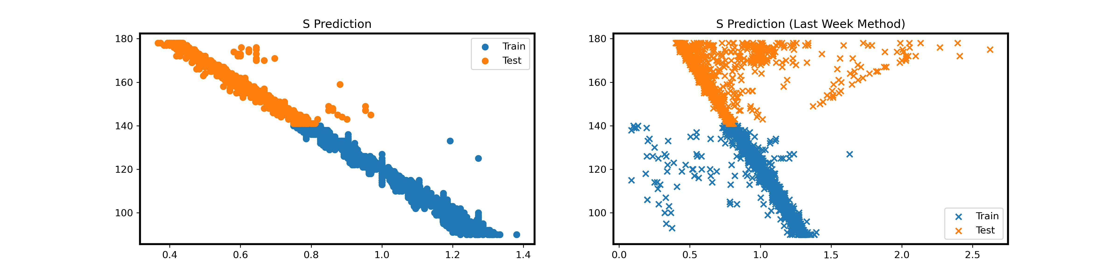
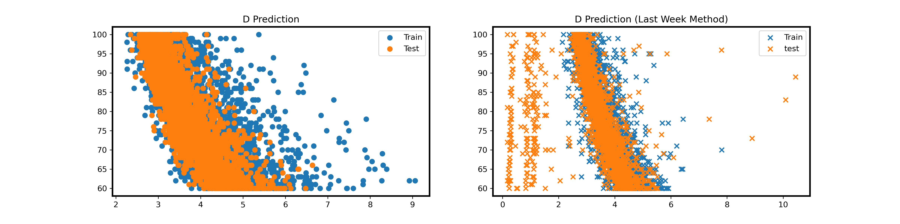
Work_2: S & D prediction in the noise level of 0.8
This week
Last week
S prediction is much better this week
Both of them have many outliers with different patterns.
Notes:
We can clearly see that, compared to result of last week, there less outliers for the S this week.
The correlation related to S this week is extremely strong.
However, for the D, both last week's method and this week's method have many outliers, and the patterns of these outliers are completely different. It is difficult for us to visually determine which one has a better effect for prediction.

Slide 12
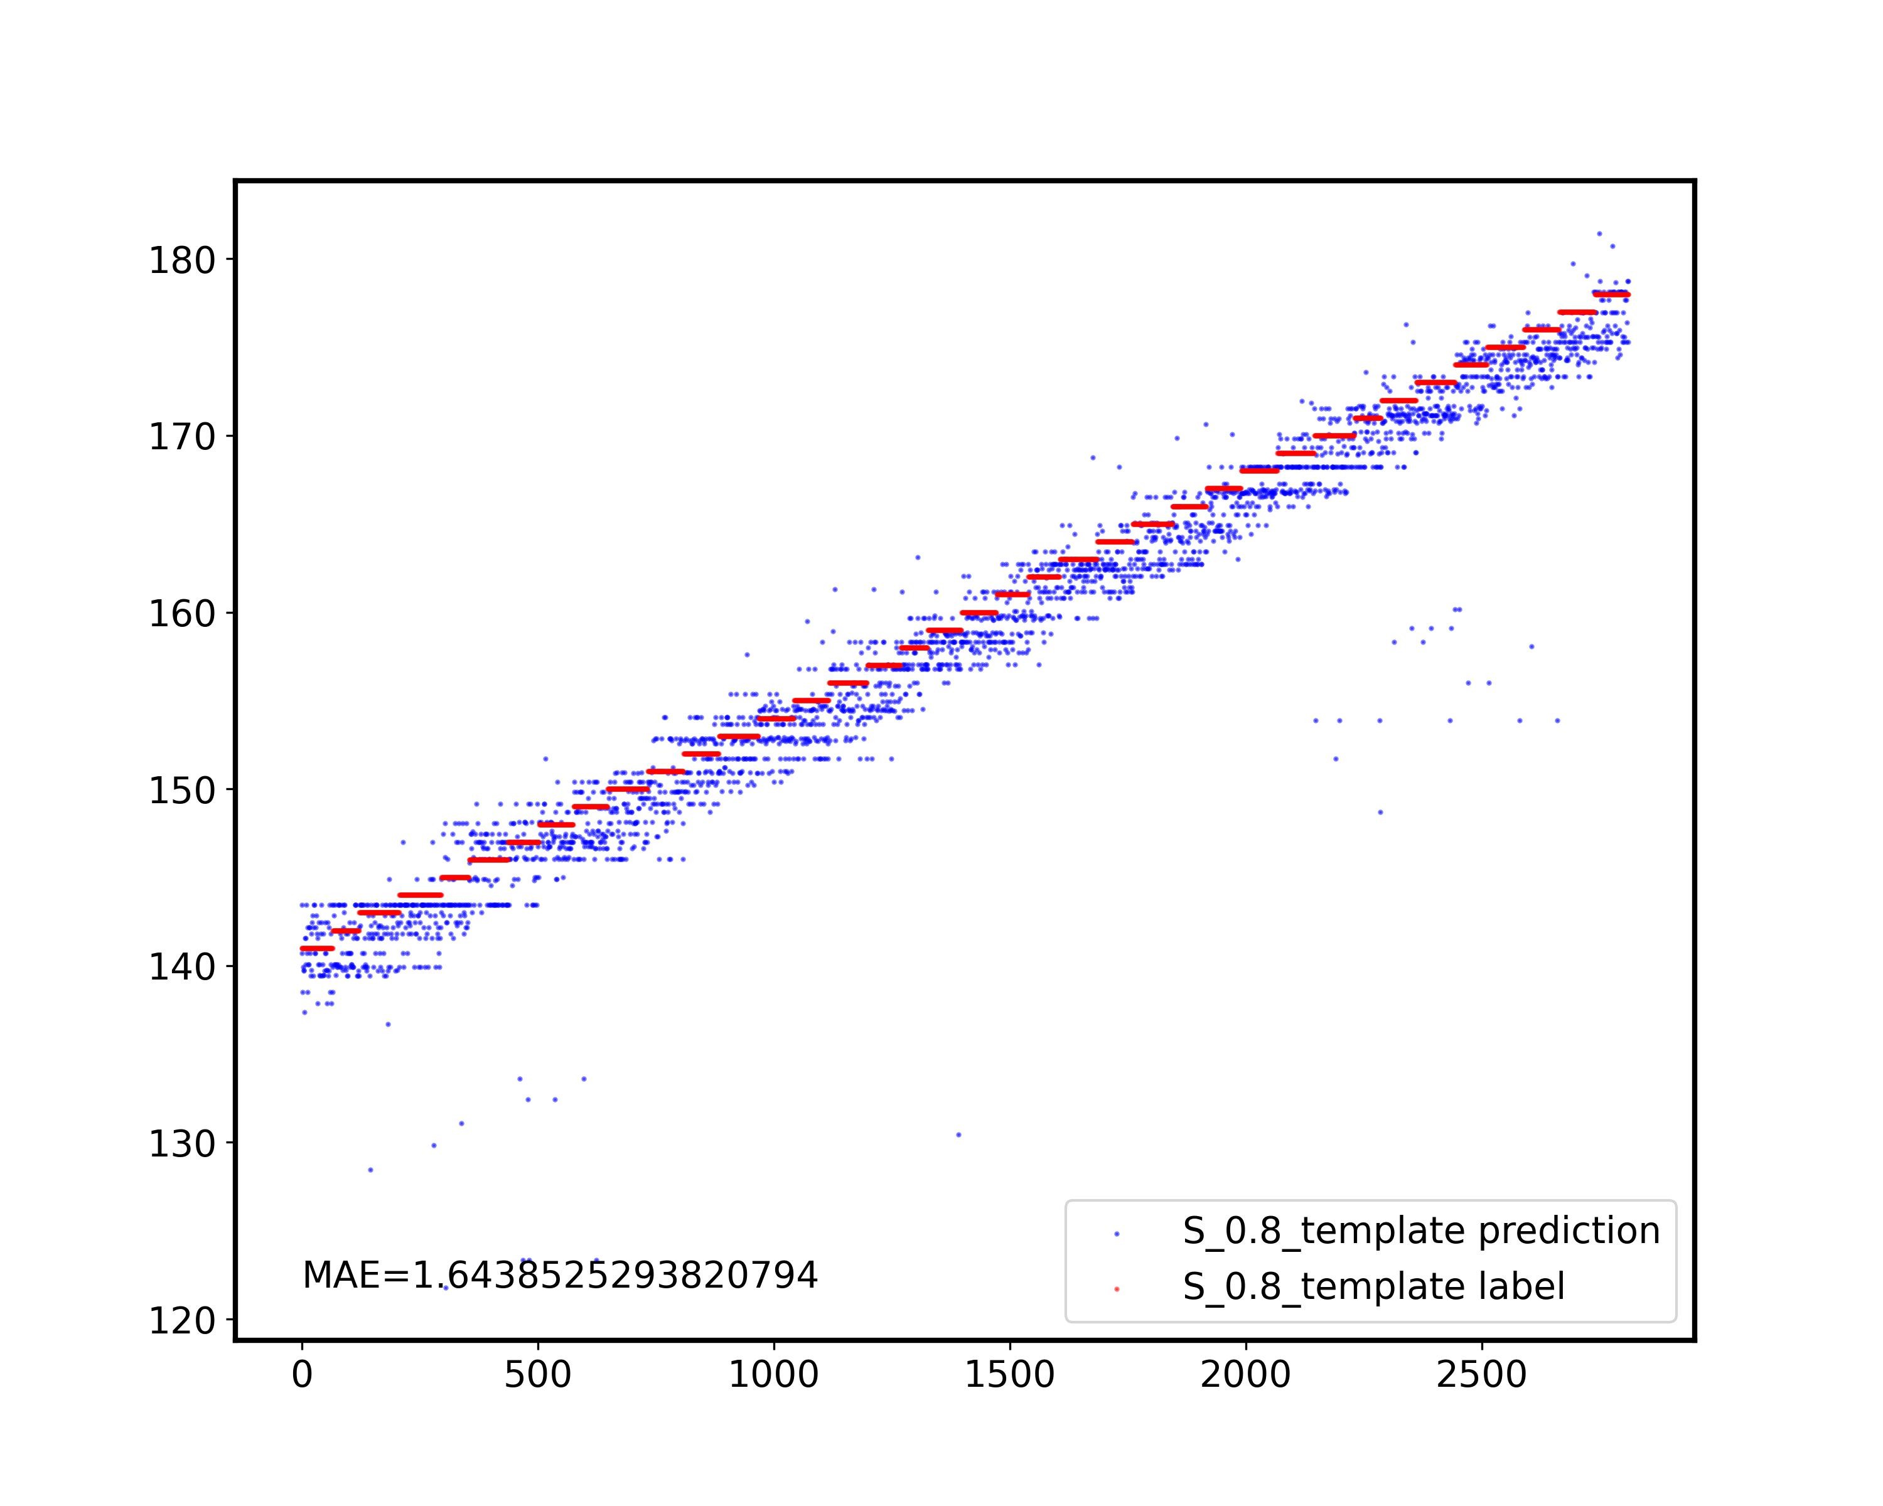
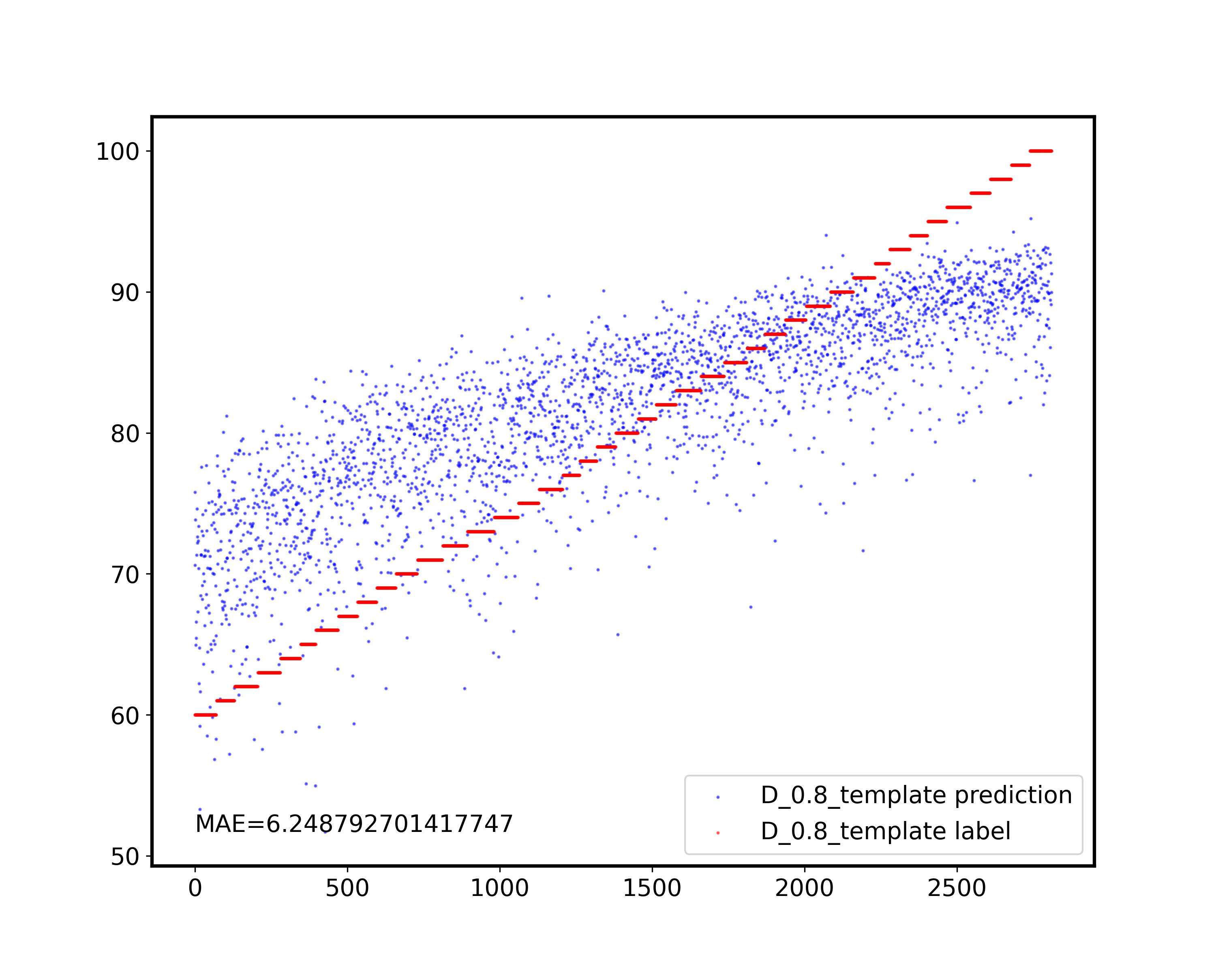
Work_2: S & D prediction in the noise level of 0.8
S
D
Nice!
The effect of D drops slightly, from 5.8 to 6.2.
Notes:
Here is the result for both "S" and "D".
The effect of "S" is extremely good, but the effect of "D" drops slightly. It went from 5.9 to 6.2.

Slide 13
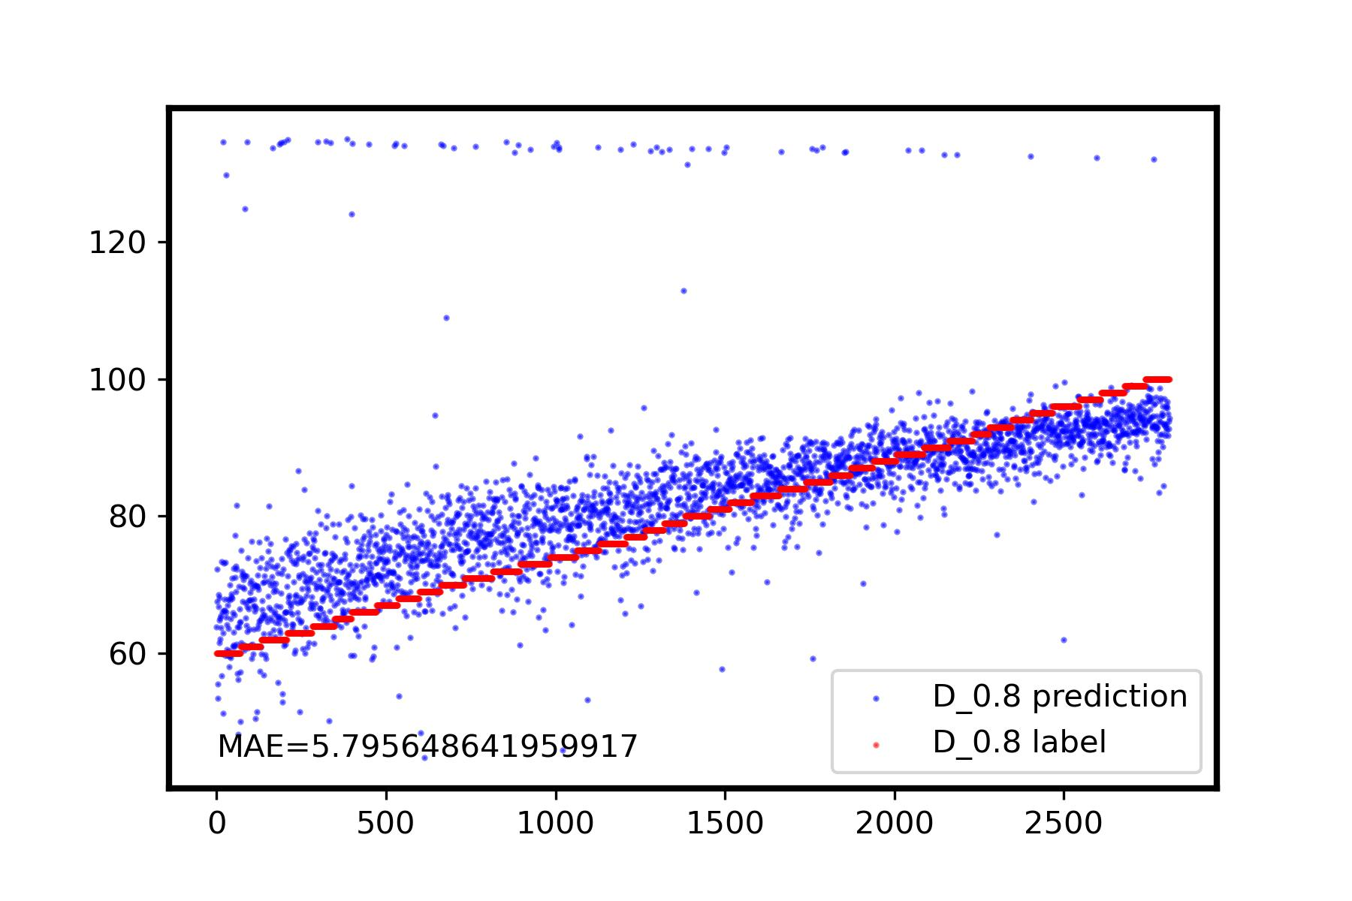
Obtaining templates from signals after slicing has a significant impact on the height of small peaks.
Work_2: S & D prediction in the noise level of 0.8
This Week
Outliers are centered in train dataset, leading to a scattered distribution of predicted values.
Last Week
Outliers are concentrated in test dataset, leading to a centered distribution of predicted values, but there are many outliners.
Notes:
I analyze the result of D prediction.
This week's method results in all the outliers being concentrated in the train dataset, leading to a very scattered distribution of predicted values.
The reason for the outliers is that when obtaining templates from the signal after slicing,
I use the method of averaging, which has a significant impact on the height of small peaks.
Last week's method, on the other hand, concentrated all the outliers in the test dataset. The distribution of predicted values is more centered, but there were many outliers.

Slide 14
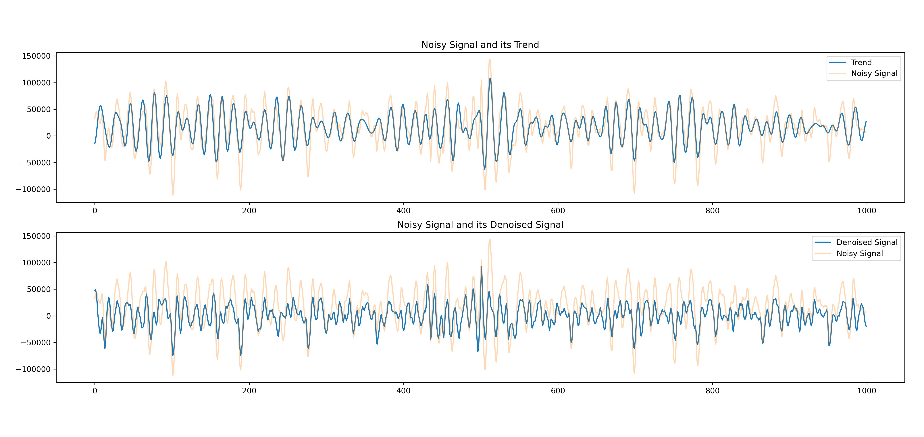
Work_2: S & D prediction in the noise level of 0.8
In real data, this method doesn't work
Notes:
It's unfortunate that in real data, this method doesn't work. I need to invest more effort in further understanding the types of noise present in real data.

Slide 15
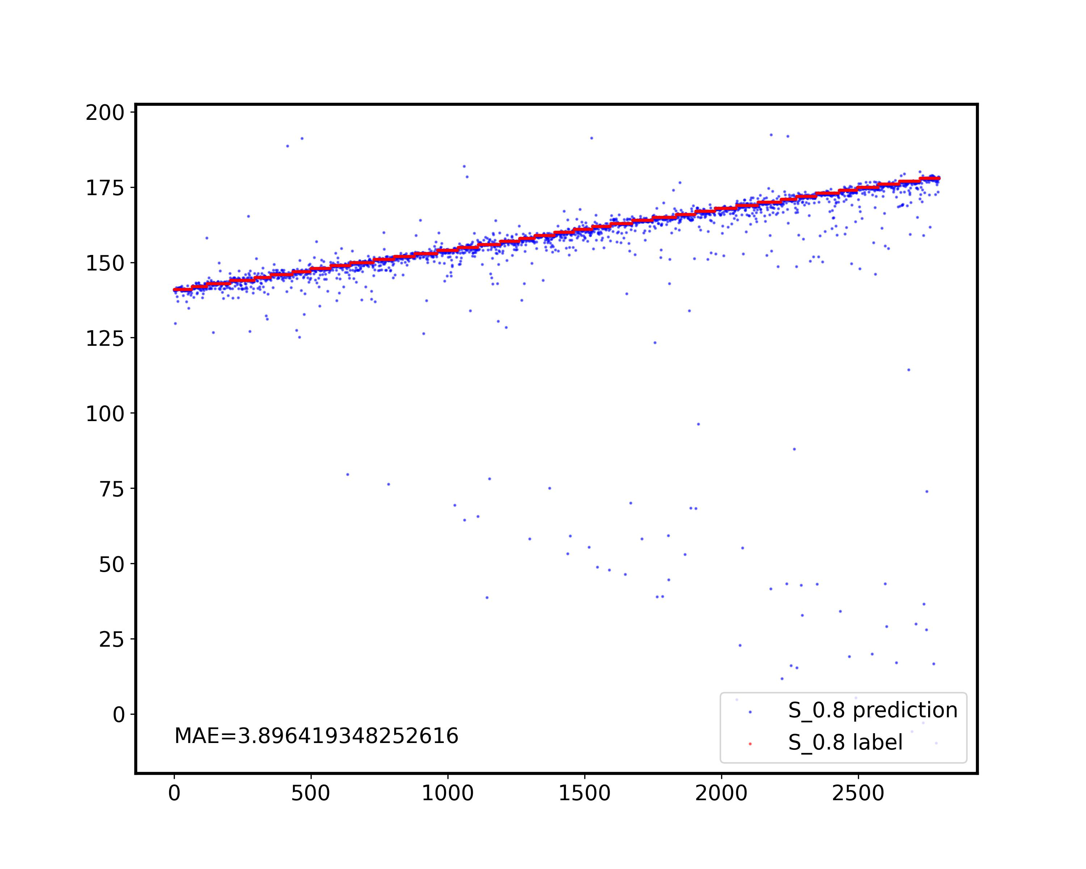
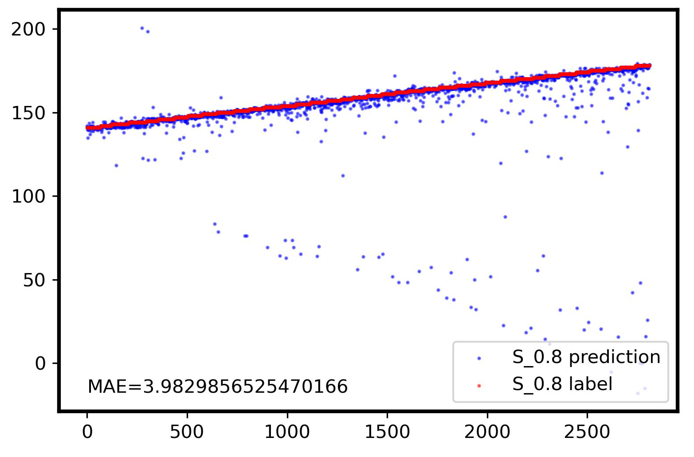
Work_3: S & D prediction in the noise level of 0.8 with Respiratory
S
D
With Respiratory
No Respiratory
Notes:
In work3.
I reintroduced the influence of breathing, and you can see that for the S prediction, breathing has almost no effect. However, D drops significantly from 5.8 to 7.1. I am unable to find an effective method to eliminate the impact of breathing."

Slide 16
Work_4: Theoretical knowledge Learning
Signals and Systems
Probability for Computer Scientists
Course: EE120, Berkeley
This week’s Progress:
None
Next week’s plan:
Lecture 10 (the DFT; FIR filters)
Lecture 11 (Fourier transforms in two dimensions)
Finish 1 lab
Course: CS109, Standford
This week's progress:
Part * 12
Next week’s plan:
Part * 12
Notes:
Work_4 is the Theoretical knowledge Learning
I Spend a lot of time exploring the automatic SSA grouping.
So this week, I have no progress in signals and systems. I will spend more time on it next week.
As for the probability, I proceed as expected.

Slide 17
Questions
“Can we simulate the reflection, refraction and resonance noises to generate the simulated dataset similar to this real data set?” Perhaps you could provide me with more detailed information about the noise. I couldn't find specific information about “refraction and resonance noises in signal processing”.

Slide 18
Thanks!

